Slide 1
Temperature Forecasting with ARIMA
By Gopalakrishnan Kumar, MTech IIT-Bombay,
Freelance Data Science Consultant
LinkedIn: Profile Link : https://www.linkedin.com/in/gopalakrishnankumar-a73301110/
Github:https://www.github.com/Gopalakrishnan-Kumar/
Kaggle URL- https://www.kaggle.com/gopalkk2

Slide 2
Google Colab URL
https://colab.research.google.com/drive/1vTu4BPX2Lls42QhIeVw5bZxIhV5pL57D?usp=sharing

Slide 3
Introduction
Temperature forecasting is crucial for climate monitoring, agriculture, energy planning, and disaster management. Accurate forecasts help governments, businesses, and individuals make informed decisions.
In this project, we used a synthetic dataset (2010–2024) that simulates daily temperatures with seasonality (summer/winter cycles) and random fluctuations. After performing Exploratory Data Analysis (EDA), we applied the ARIMA (AutoRegressive Integrated Moving Average) model to forecast future average monthly temperatures.

Slide 4
Dataset Overview
Period: January 2010 – December 2024
Frequency: Daily (resampled into monthly/yearly for EDA)
Column:
Date → daily timestamps
Temperature → average daily temperature in °C

Slide 5
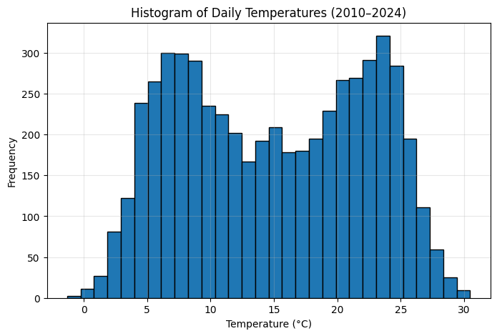
Data Visualization

Slide 6
Exploratory Data Analysis (EDA)
3.1 Histogram of Daily Temperatures
The histogram of daily temperatures (2010–2024) showed a
bell-shaped distribution.
Most daily temperatures lie between 5°C and 25°C, with a peak around 15°C.
This reflects the seasonal cycle of cold winters and hot summers.
The spread (variance) is caused by natural daily fluctuations
and random noise.
📊 Insight: The distribution confirms a seasonal climate cycle
with moderate variability.

Slide 7
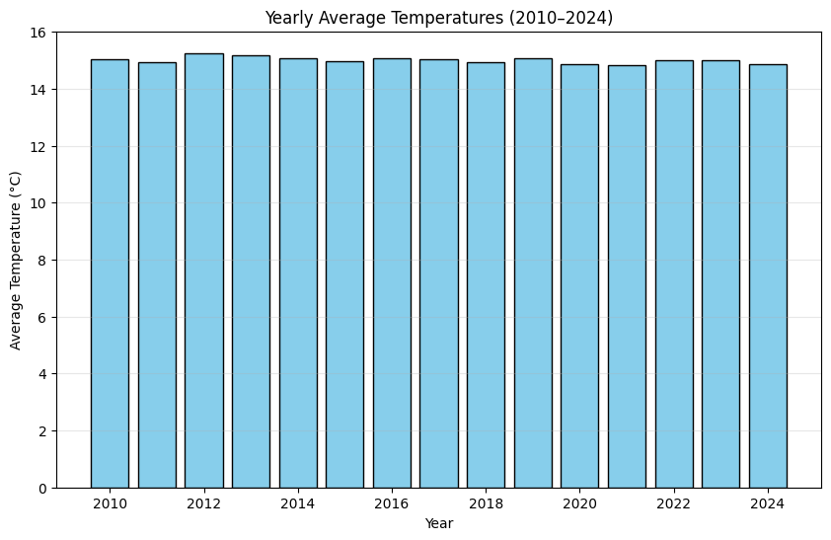
Data Visualization

Slide 8
Exploratory Data Analysis (EDA)
3.2 Yearly Average Temperatures (Bar Chart)
Yearly averages showed relatively stable long-term trends with only minor fluctuations.
This is expected because the dataset was generated with a repeating sinusoidal pattern and random noise.
No significant warming or cooling trend was observed in this synthetic dataset.
📊 Insight: In real-world datasets, yearly averages could reveal climate change signals (e.g., global warming).

Slide 9
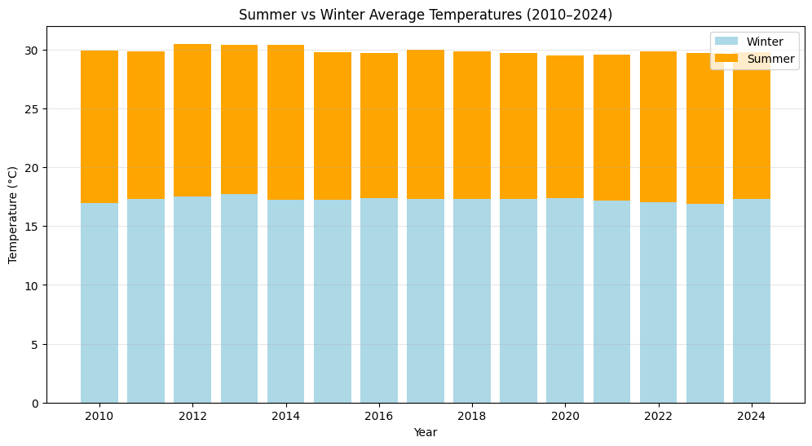
Data Visualization

Slide 10
Exploratory Data Analysis (EDA)
3.3 Summer vs Winter Comparison (Stacked Bar Chart)
Summer (June–August) and Winter (December–February) averages were computed for each year.
The stacked bar chart highlighted the combined contribution of summer and winter to yearly temperature patterns.
Winters consistently had much lower averages compared to summers, showing a strong seasonal effect.
📊 Insight: The dataset clearly captures seasonality, which is crucial for forecasting models like SARIMA.

Slide 11
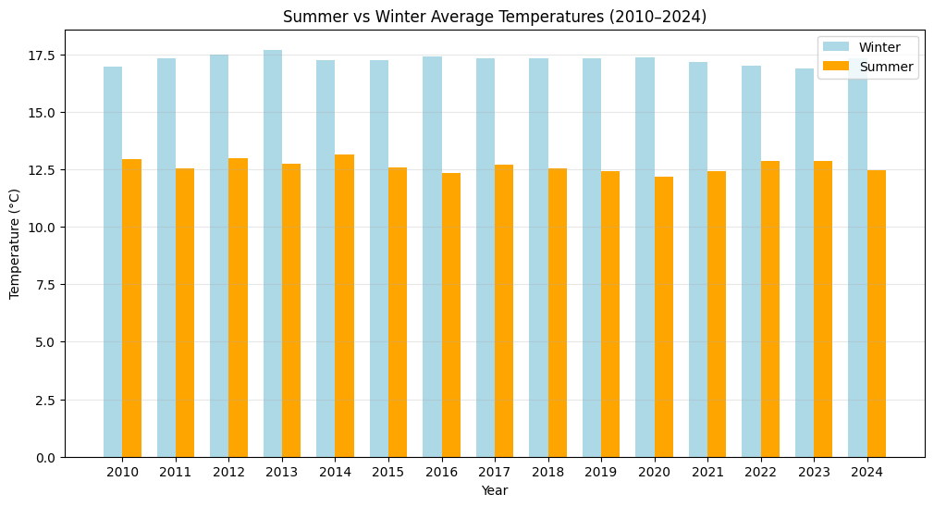
Data Visualization

Slide 12
Exploratory Data Analysis (EDA)
3.4 Summer vs Winter Side-by-Side (Grouped Bar Chart)
When plotted side by side, the difference between summer and winter averages was clearer.
Each year consistently showed a 10–15°C gap between summer and winter.
Minor variations across years reflect random noise.
📊 Insight: Direct comparison reinforces the predictable seasonal cycle in temperatures.

Slide 13
Key Takeaways from EDA
Distribution: Temperatures follow a near-normal distribution centered around 15°C.
Stability: Yearly averages remain stable, consistent with a synthetic sinusoidal dataset.
Seasonality: Clear seasonal pattern with warm summers and cold winters.
Forecasting Suitability: Since the data exhibits strong seasonality and stable averages,
it is well-suited for ARIMA/SARIMA models

Slide 14
Next Steps
Apply ARIMA for short-term forecasting (already demonstrated).
Extend to SARIMA to explicitly capture seasonal patterns.
Try Prophet (Facebook) for trend + seasonality modeling.
Experiment with LSTM neural networks for long-term forecasting.
Build an interactive dashboard (e.g., Power BI, Tableau) to visualize
seasonal trends and forecasts.

Slide 15
Conclusion
The EDA confirmed that the synthetic temperature dataset exhibits realistic seasonal variations with a sinusoidal pattern. Temperatures oscillate between cold winters and warm summers with predictable cycles. These insights validate the use of time series forecasting techniques for predicting future temperatures.
Such forecasting can have real-world applications in energy consumption planning (heating/cooling), agriculture, tourism, and climate risk management.

